Slide 1
Same four stealth attacks. Three tools, three verdicts.
Lead: Ravindra Shukla
Inside authorized access, the most dangerous threats never trip a threshold — so most tools miss them, or bury the signal in false alarms.
TRADITIONAL SIEM
INTERMEDIATE
V-INTELLIGENCE
point-anomaly tools
statistical z-score
behavioral entities
Isolation Forest / SVM / LOF
Flags the biggest outliers
Cohort + drift + known-bad
fused into one ranked score
Scores each user vs a threshold
>
Catches 1 of 4
>
0 of 4 caught
…and alarms on nearly everyone
no threat context
4 of 4 caught
Why it matters
The tools most agencies run today see all four attackers as normal employees. V-Intelligence catches every one — and names why.
CONFIDENTIAL | 22nd Century Technologies | V-Intelligence UEBA — Executive Brief
1

Slide 2
Same logs, read as living behavioral entities
Lead: Ravindra Shukla
No new data. The identical security logs become connected, time-aware entities that reveal where a user is heading — not just what crossed a line today.
SAME LOGS
BEHAVIORAL TWIN
DETECTION
no new data needed
same logs, in context
one ranked verdict
Sign-in & access logs
Tracked over time (drift)
Behavioral risk score
Network & endpoint records
>
Compared to its cohort (peers)
>
+ named technique evidence
User & device context
Matched to known-bad profiles
Calibrated, auditable
Explained in plain language
Catches low-and-slow attacks
Key point
Same data, a richer model — it captures what a user HAS done plus where they’re HEADING.
CONFIDENTIAL | 22nd Century Technologies | V-Intelligence UEBA — Executive Brief
2

Slide 3
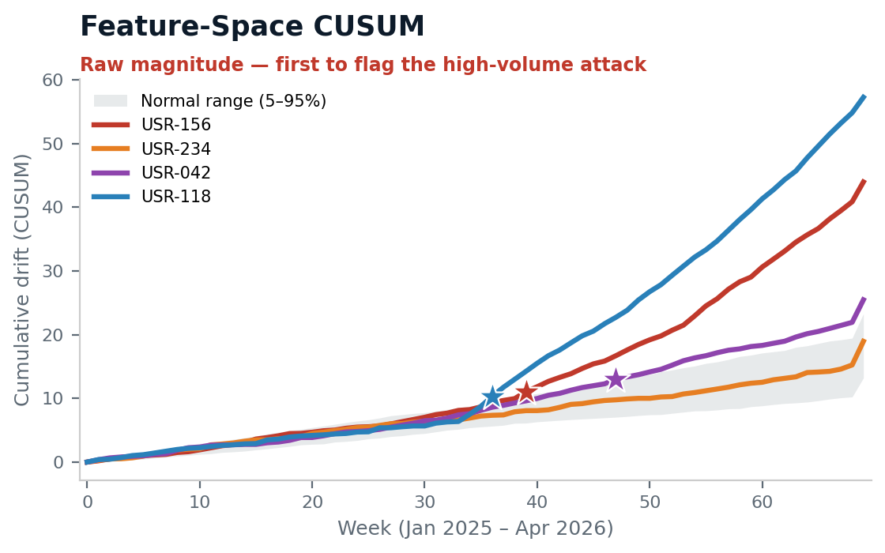
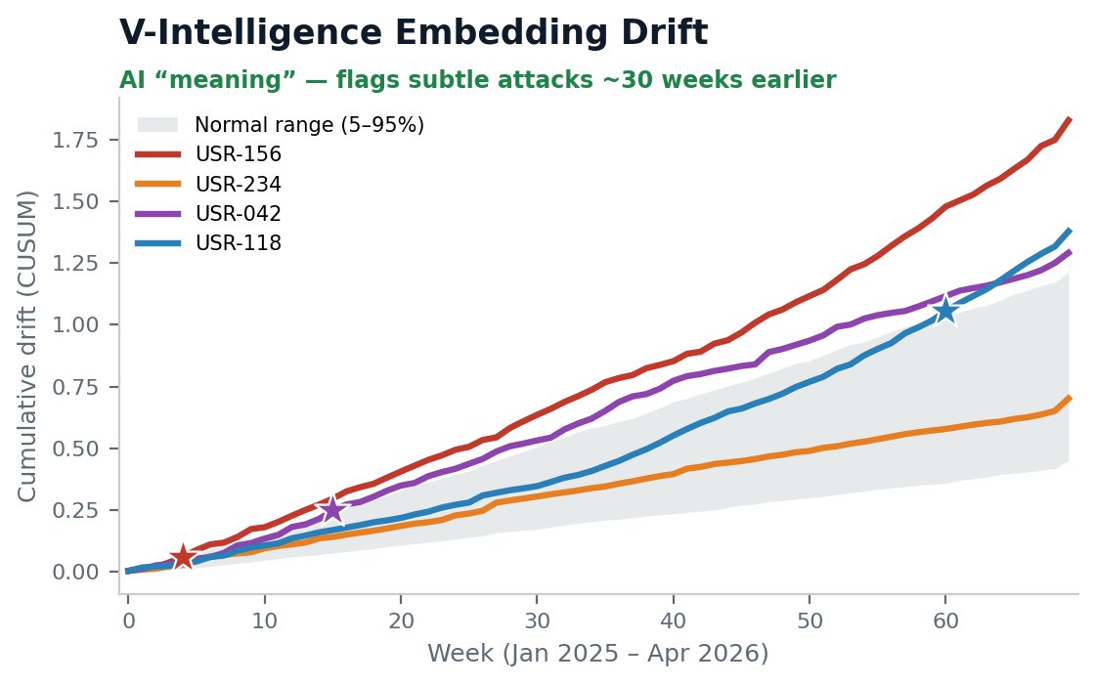
On any given day, the attacker looks normal
Lead: Ravindra Shukla
Two lenses read the same logs: raw numbers catch the noisy attack first; the AI “meaning” lens catches the subtle ones ~30 weeks sooner. The stealth APT hides from both on drift alone — which is why we fuse multiple fronts.
First clear detection (★): USR-118 wk 36 · USR-156 wk 4 · USR-042 wk 15 · USR-234 — caught by known-bad profile, not drift
Each lens has a blind spot. Running them together — plus the cohort and known-bad fronts — is what catches all four.
Synthetic / representative demo data — to be revalidated on DLA data before production claims.
CONFIDENTIAL | 22nd Century Technologies | V-Intelligence UEBA — Executive Brief
3

Slide 4
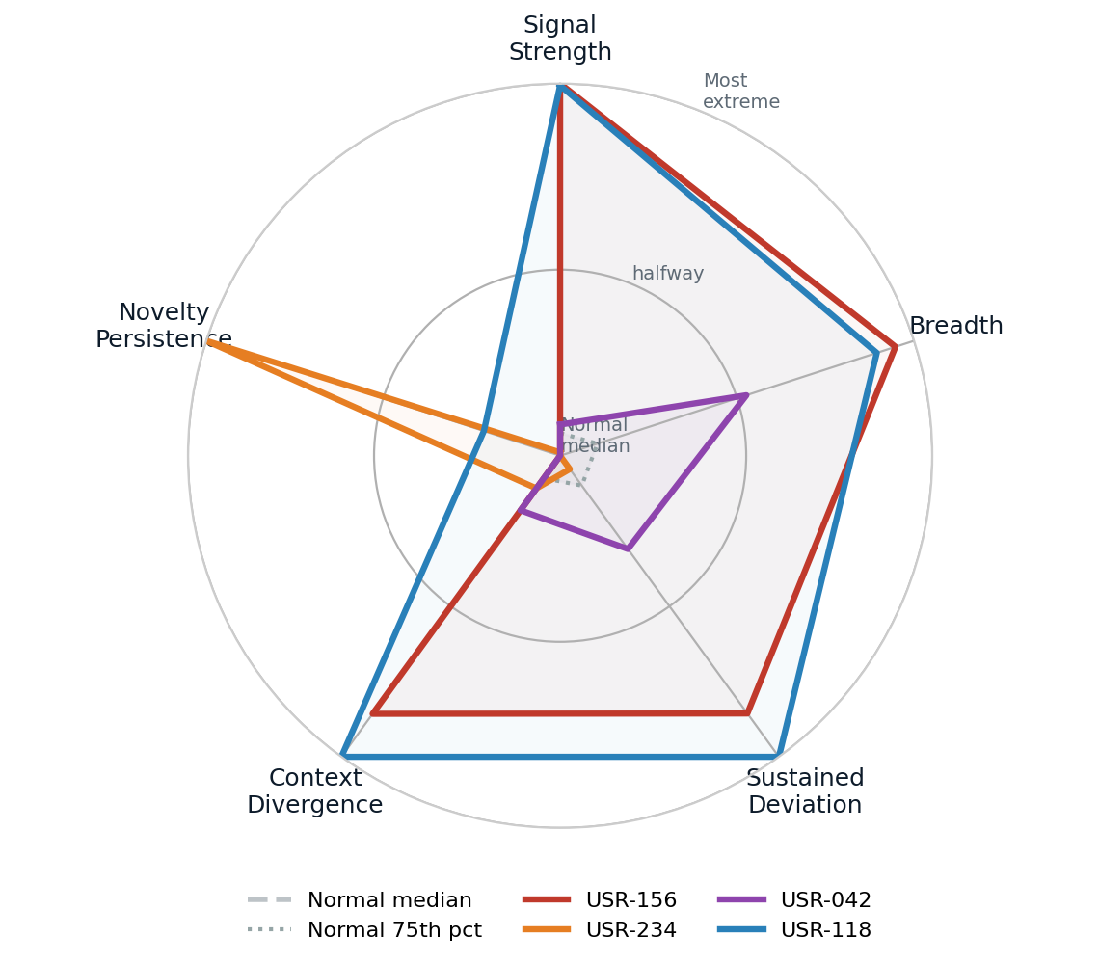
No normal user is extreme on every front at once
Lead: Ravindra Shukla
Each attacker pushes past the normal cluster on a different behavioral phase. That multi-phase extremity is the fingerprint a single threshold can’t see.
Grey = normal users (median & 75th percentile): a tight cluster near the center.
The five behavioral phases:
• Signal Strength — how far behavior departs from peers
• Breadth — how many behaviors shifted at once
• Sustained Deviation — how long the shift persisted
• Context Divergence — how unlike its role-group it became
• Novelty Persistence — new connections (e.g., C2) that keep recurring
USR-156 dominates Signal Strength & Breadth; USR-234 spikes on Novelty Persistence (its C2 beacon). No normal user reaches these extremes on multiple phases at once.
Synthetic / representative demo data — to be revalidated on DLA data before production claims.
CONFIDENTIAL | 22nd Century Technologies | V-Intelligence UEBA — Executive Brief
4

Slide 5
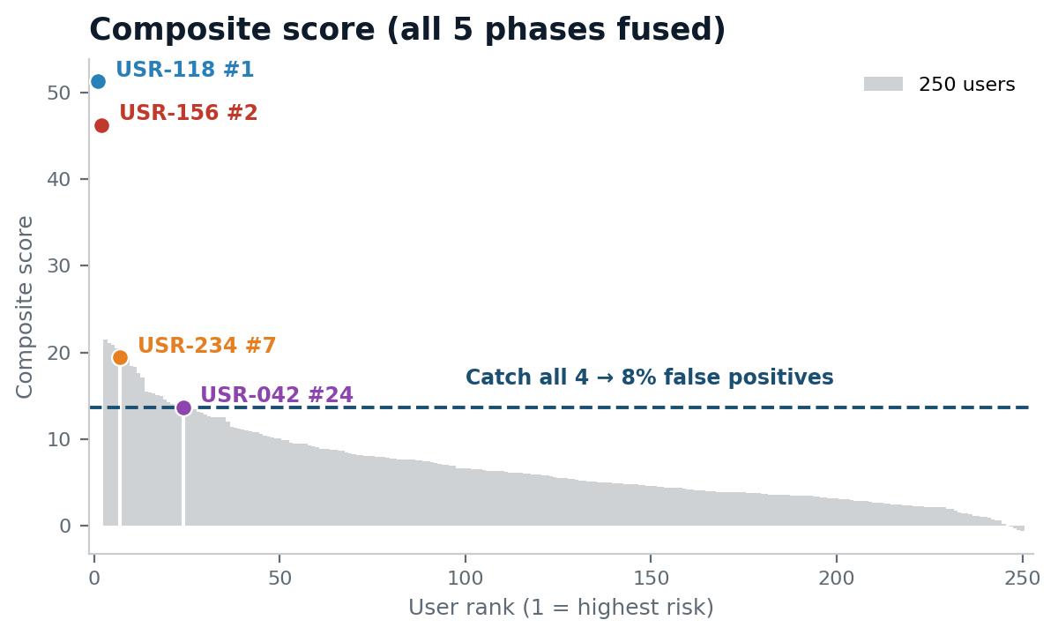
Every attack caught — with the cost stated honestly
Lead: Ravindra Shukla
Fused into one score, all four campaigns rank above the line that catches all four. A complementary known-bad detector catches the same four at zero false positives.
0 → 4 of 4
stealth attacks caught that legacy scored as normal
• Known-bad profiles: 4 of 4 at 0 false positives
• Composite ranking: 4 of 4 at ~8% false positives
• Subtle attacks flagged up to ~30 weeks earlier
• Every alert names the behavior that fired — auditable
Synthetic / representative demo data — to be revalidated on DLA data before production claims.
CONFIDENTIAL | 22nd Century Technologies | V-Intelligence UEBA — Executive Brief
5

Slide 6
What this enables for the mission
Lead: Ravindra Shukla
From a daily flood of alerts to one ranked, explainable verdict — on the logs you already collect.
Triage by risk — one risk-ranked list of entities, not thousands of threshold alerts.
Explainable verdicts — every flag names the behavior, mapped to MITRE ATT&CK.
Slow-and-low coverage — catches insiders and APTs that stay inside every threshold for months.
Deployable where you operate — containerized; runs on-premises or in an enclave.
Bottom line: catch what rules miss, before it becomes a breach — with evidence a SOC analyst and an auditor can both trust.
Synthetic / representative demo data — to be revalidated on DLA data before production claims.
CONFIDENTIAL | 22nd Century Technologies | V-Intelligence UEBA — Executive Brief
6

